Slide 1



GENDER EQUALITY
AWARENESS RAISING
WORKSHOP FOR SMEs

Slide 2



1. GENERAL PRESENTATION

Slide 3

WELCOME!
AGENDA
Photo 2
Time
14:30 – 15:15 | General presentation Welcome notes Participants presentation European framework for gender equality What is Penelope project What is Gender Equality and Why should it be on the SMEs’ agenda?
15:15 – 15:45 | Platform discovery How to connect to the platform Presentation of the mains parts of the platform
15:45 – 16:25 | Practical part Workplace culture and institutional transformation Group activity
16:25 – 16:30 | Evaluation

Slide 4

WELCOME!
Photo 1
PRESENTATIONS
What picture evokes for something related to gender equality ?
Choose a picture on the table
Then give your first name, the name of your organization, and explain in a few words why you chose this image.

Slide 5




What is the Penelope Project?
European framework for gender equality
2030 Agenda for Sustainable Development → gender equality as a fundamental goal (Goal 5)
EU Gender Equality Strategy 2020-2025 → a Europe where men and women can thrive and lead without stereotypes.
The EU Directive 2006/54/EC encourages companies to promote a systematic equal treatment in employment, training, and career advancement, which can be effectively achieved through the development and implementation of diverse gender mainstreaming strategies.
Industrial development is not a gender-neutral process → It is essential to equip SMEs and cluster organizations’ staff with the understanding of core gender mainstreaming principles
This is where the Penelope Project comes into play!
COST ANALYSIS
Notes:
2030 Agenda for Sustainable Development highlights gender equality as a fundamental goal (Goal 5),
EU Gender Equality Strategy 2020-2025 envisions a Europe where men and women can thrive and lead without stereotypes.
Industrial development is not a gender-neutral process, and it can lead to unequal opportunities if the strategies for the development and promotion of industrialization, technology and innovation do not take into account the gender dimension.
The EU Directive 2006/54/EC encourages companies to promote a systematic equal treatment in employment, training, and career advancement, which can be effectively achieved through the development and implementation of diverse gender mainstreaming strategies.
It is essential to equip cluster organizations’ staff with the understanding of core gender mainstreaming principles

Slide 6





What is the Penelope Project?
Objectives
3 years to equip SMEs, clusters, and stakeholders with concrete solutions to implement sustainable gender equality strategies.
Penelope Project partners
Expected results
  A training handbook containing best practices, interviews and tools
  20 awareness-raising videopills
  A Virtual Learning Environment, free of charge for five years
  A training methodology (Workshops for SMEs, replicable by clusters)
.
COST ANALYSIS
Notes:
Objectives and expected results of Penelope
The PENELOPE project was created to equip SMEs, clusters, and stakeholders with concrete solutions to implement sustainable gender equality strategies.
Penelope Project partners
PENELOPE aims, first, to develop innovative tools for gender mainstreaming strategies in SMEs, then rely on clusters in different sectors to ensure the transfer and implementation of these tools within SMEs.
A pioneering and innovative training handbook containing best practices from EU clusters and policy makers, interviews with key-industry representatives and a guidebook of tools or implementingender mainstreaming in SMEs
A set of video pills as useful resources on gender mainstreaming and on how companies can increase and keep female participation in the labor market.
A Virtual Learning Environment, free of charge for five years, offering adaptive trainings for both clusters and SMEs.
A training methodology for the clusters that what to train their members to use the tools provided by the project

Slide 7
What is gender equality and why should it be on the SMEs’ agenda?
Notes:
Notions of equality - What is Gender equality ?
Equal rights for women and men = a fundamental goal of the European Union, which was created on the principle of equality: a Union where women and men, girls and boys, in all their diversity, are free to pursue their chosen path in life, have equal opportunities to thrive, and can equally participate in and lead our society.
When we talk about equality between men and women at work, the first thing that comes to mind is equal pay.
But it also concerns : hiring, training, career development, working conditions, health and safety at work, work-life balance.

Slide 8
What is Gender equality at work ?
Equal rights for women and men = a fundamental goal of the European Union
→ a Union where women and men, girls and boys, in all their diversity, are free to pursue their chosen path in life, have equal opportunities to thrive, and can equally participate in and lead our society.
Gender equality = ? Not only ! It also concerns :
If we look at these aspects, other types of inequality can be observed that need to be taken into account.
Equal pay
Hiring
Access to training
Work-life balance
Working conditions
Health and safety at work
Career progression
Notes:
Notions of equality - What is Gender equality ?
Equal rights for women and men = a fundamental goal of the European Union, which was created on the principle of equality: a Union where women and men, girls and boys, in all their diversity, are free to pursue their chosen path in life, have equal opportunities to thrive, and can equally participate in and lead our society.
When we talk about equality between men and women at work, the first thing that comes to mind is equal pay.
But it also concerns other topics that receive less attention, but where inequalities between men and women also exist, like hiring, training, career development, working conditions, health and safety at work, work-life balance.

Slide 9
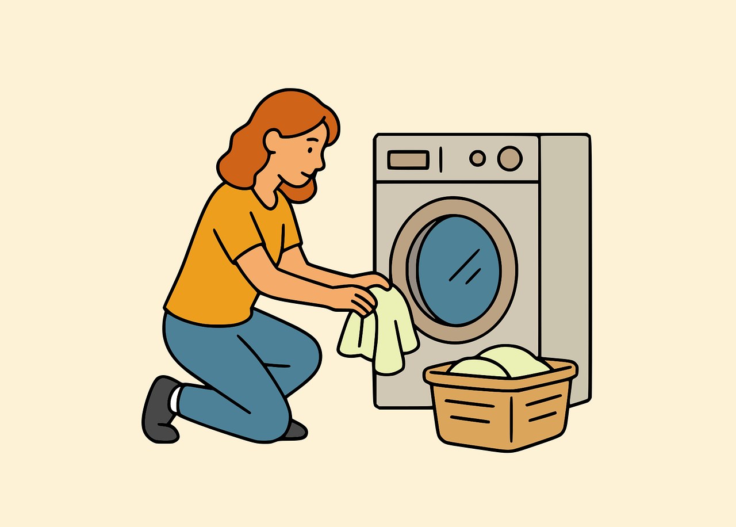

What gender inequality is a social construction ?
Hetero-patriarchal binary system assigns specific roles and attributes to men and women
Productive work —typically performed by men— is financially and socially recognized, while reproductive and care work —largely performed by women— remains invisible, unpaid, and unprotected by labor rights.
But these role differences have no biological explanation : they are social construction.
So they can be changed through education, policies or cultural change.
Notes:
Why gender inequality is a social construction?
Hetero-patriarchal binary system assigns specific roles and attributes to men and women, positioning men as dominant in the public and professional spheres while limiting women’s roles to caregiving and domestic responsibilities.
Productive work —typically performed by men— is financially and socially recognized, while reproductive and care work —largely performed by women— remains invisible, unpaid, and unprotected by labor rights.
Understanding gender inequality as a socially constructed and structural issue rather than an individual or biological problem is crucial for dismantling discrimination.
Social constructs = created by societies => they can be challenged and changed through policies, education, and cultural shifts.

Slide 10

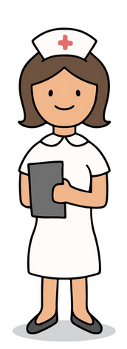

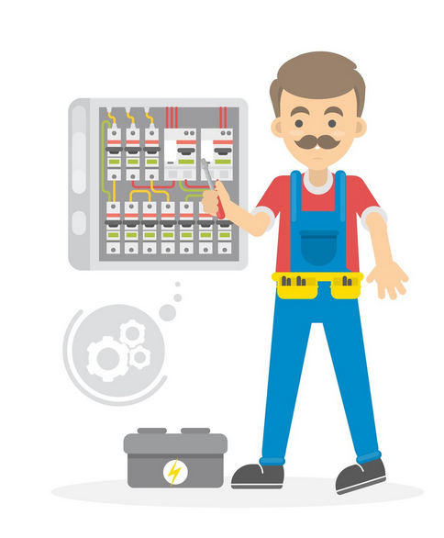
Consequences of gender stereotypes in the workplace
Sectoral gender segregation
Unfair distribution of paid and unpaid work
Gender stereotype
Sexual harassment
Notes:
Sectoral gender segregation
Males predominate in highly compensated industries like ICT
Women are concentrated in low-paying fields like care, health, and education jobs
Unfair distribution of paid and unpaid work:
The OECD (The Organisation for Economic Co-operation and Development): gender inequality in unpaid care work is the missing link in the analysis of gender gaps in labor outcomes
Indeed, women devote a disproportionate amount of time to unpaid care work, which has a negative impact on their career development and wages.
Such as caring for children or the elderly, they tend to reduce their paid work, which creates a gap in work experience between men and women and a reduction in women's income
Gender stereotype
Example of gender stereotypes taking place in the workplace (which are totally untrue but which still have an impact on women's careers today) :
qualities like intelligence and agency make women = “bossy”, but men = good leadership qualities.
Women are believed to be more emotional (and, therefore, less rational) than men.
A man might share the same idea that a woman shares at work and end up getting credit for it because he’s seen as more of a leader.
Sexual harassment
Sexual harassment is yet another obstacle an obstacle to directing career choices towards certain jobs (particularly in highly masculine environments). Even if changes in the public opinion made sexual harassment in work environments more likely to be reported, it remains a important issue against gender equality.
Gender inequality in the workplace takes many forms — unequal pay, disparity in promotions, incidents of sexual harassment, discrimination, etc. and has many causes, one of the most important being the inherent belief that exists in most societies, that men are simply better equipped to handle certain jobs, which leads to the division of jobs. Most of the times, those are the jobs that pay the best and this discrimination results in lower income for women.
Some final data to leave you with:
The gender pay gap is at 12% at EU level and 20% worldwide - ILO, 2022.
10% of the world’s Heads of State today are women - UN Women, 2024.
Today women enjoy less than two-thirds of the legal rights available to men—not three-quarters as previously estimated - World Bank, 2024.

Slide 11
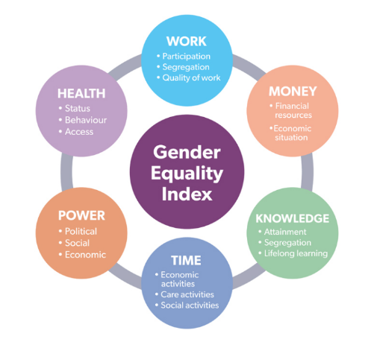
How is gender inequality measured?
At European level, a Gender equality Index exists to compare countries.
It is based on 6 domains and gives the EU and the Member States a score from 1 to 100 (A score of 100 would mean that a country had reached full equality between women and men).

Slide 12
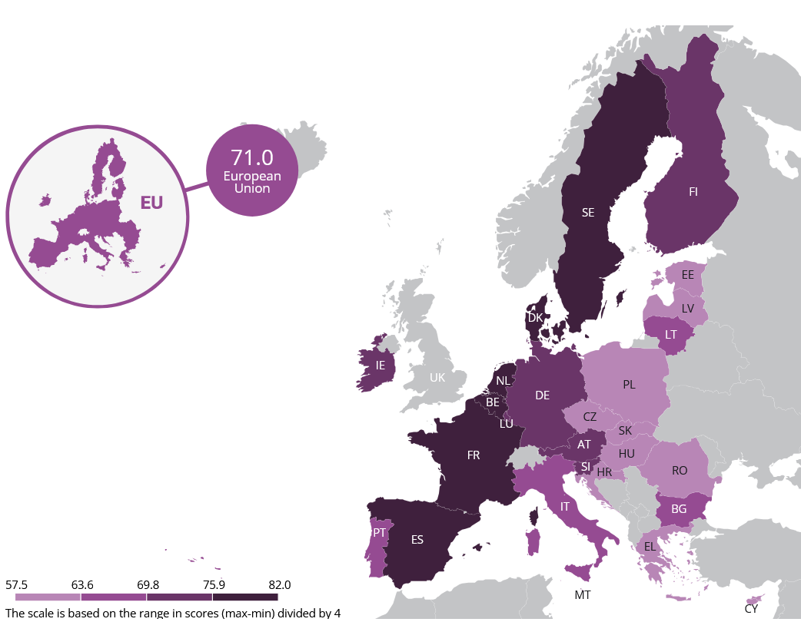
How is gender inequality measured?
The Gender Equality Index in 2024 in EU :
(base on data from 2022)

Slide 13

How is gender inequality measured in companies?
At National level → see each country legislation and mechanisms for diagnosing gender equality in the workplace.
In France :
Diagnosis of the situation of men and women in the company
An action plan with actions in at least 3 of the 9 defined
The 9 domains are : Remuneration (required), Hiring, Training, Career advancement, Qualification, Classification, Working conditions, Occupational health and safety, Work-life balance.
The professional equality index (to be calculated and published on the company's website).
Notes:
At National level, each country has its own regulations and mechanisms for diagnosing gender equality in the workplace.
In France :
Every company with more than 50 employees is required to
Conduct a diagnosis of the situation of men and women
To propose an action plan with actions in at least 3 of the 9 defined domains (with targets for progress, actions and quantified indicators)
The 9 domains are : Remuneration (required), Hiring, Training, Career advancement, Qualification, Classification, Working conditions, Occupational health and safety, Work-life balance.
Calculate the professional equality index: this is a tool designed to calculate the pay gap between men and women in your company. It must be calculated and published each year, in a visible and legible manner, on the company's website.

Slide 14
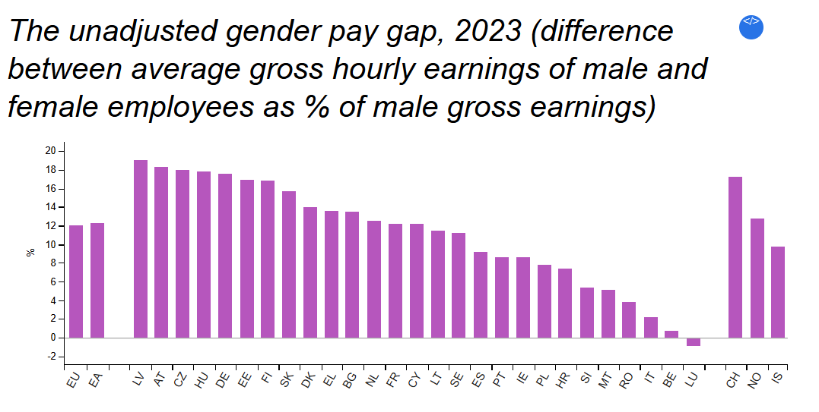
How is gender inequality measured?
In 2023, women's gross hourly earnings were on average 12.0% below those of men in the EU
the highest gender pay gap in the EU being recorded in Latvia (19.0%)
the lowest in Luxembourg (-0.9%).

Slide 15
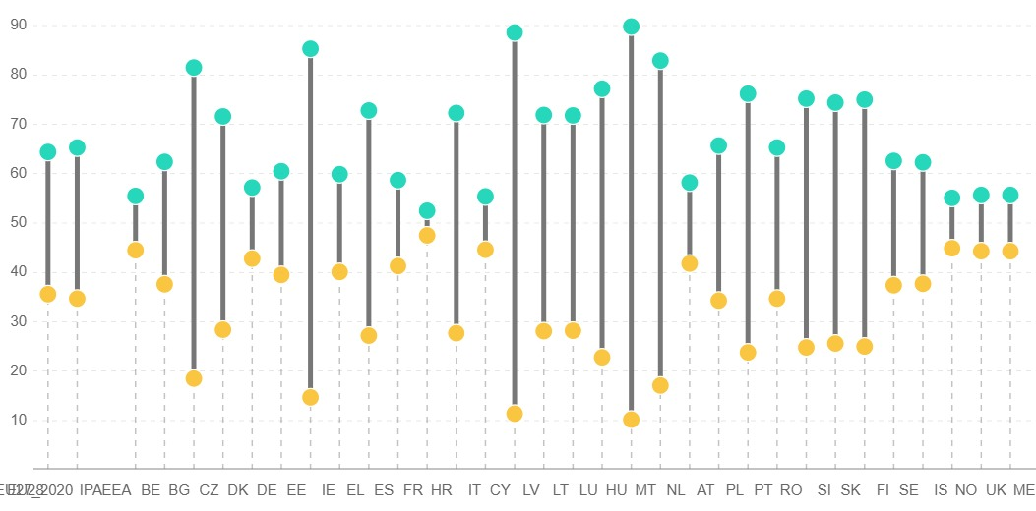
How is gender inequality measured?
Lack of representation in leadership / Glass ceiling
Women are consistently barred from leadership positions by being passed over for promotions and development opportunities
The numbers are marginally improving (although it may be due to the required quota) – at an all-time high of 33% as shown in the domain of power indicator.
EIGE statistics - Largest listed companies: presidents, board members and employee representatives – members chart
In France

Slide 16
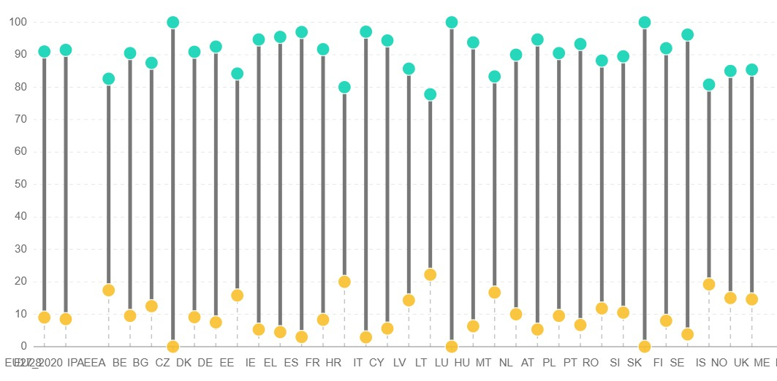
How is gender inequality measured?
However, at the top-level management there are barely 7-8% women leaders in the Fortune 500 companies. Although this has happened for the first time in the list’s 68-year history, men still made up 83% of the 533 executive officers within the corporations listed in the S&P 100. Also, managers had the biggest gender pay gaps in the EU - 23%
Largest listed companies: CEOs, executives and non-executives – CEO chart
In France

Slide 17

The benefits of reducing inequality for individuals, companies and society
Consequences of gender discrimination within the workplace:
1. Economic drawbacks
Often overlooked for promotions and lower paid → women are more likely to change jobs or industries → more turnover in the company and missing out ideas, projects, and sales
2. Stunted innovation
Less women in key decision-making and R&D → less diverse perspectives → less innovation
3. Mental health implications
Sexism at work → mental health issue like burnout → decline in productivity.
Notes:
Consequences of gender discrimination within the workplace:
1. Economic drawbacks
Women are often overlooked for promotions => stuck with lower compensation = > more likely to change jobs or industries or leave the labor force entirely.
Without diversity, organizations miss out on ideas, projects, and sales that could have positioned them as industry leaders
2. Stunted innovation
Diverse perspectives drive innovation. So, when women are excluded from key decision-making, research and development (R&D) can stagnate.
Fostering gender diversity, equity, and inclusion results in increased employee engagement and better employee retention..
3. Mental health implications
Sexism is also a mental health issue, threatening female employees’ well-being. Working as hard as their male counterparts without receiving the same recognition is draining. Discrimination and sexual harassment can quickly lead to burnout and a decline in productivity.

Slide 18

The benefits of reducing inequality for individuals, companies and society
The positive impact of implementing gender mainstreaming in the organization:
1. Legal and ethical imperatives
2. Enhanced organizational performance
3. Broader talent pool and skills diversity
4. Employee engagement and satisfaction
5. Corporate social responsibility and reputation
6. Positive economic impact
Notes:
1. Legal and ethical imperatives
Addressing the gender promotion gap is not only ethically responsible but also aligns with legal requirements, mitigating the risk of legal challenges and ensuring compliance with evolving societal expectations.
2. Enhanced organizational performance
Diverse leadership teams bring a variety of perspectives, experiences, and problem-solving approaches.
This diversity fosters innovation, creativity, and adaptability, essential qualities in today's rapidly changing business landscape.
3. Broader talent pool and skills diversity
By actively promoting gender equality in professional advancement, organizations can tap into a broader range of skills and competencies.
4. Employee engagement and satisfaction
Employees, regardless of gender, are more likely to be engaged and satisfied in an environment that values their contributions and provides equal opportunities for growth.
This positive workplace culture of inclusivity and fairness contributes to improving well-being and health at work, which leads to a more motivated workforce and to higher retention rates.
5. Corporate social responsibility and reputation
Companies that champion gender equality in professional advancement are perceived as ethical, progressive, and socially responsible, which positively impacts their reputation.
This can lead to increased brand loyalty and attract top talent seeking inclusive work environments.
6. Positive economic impact
Closing the gender promotion gap has positive economic implications on both micro and macro levels.
At the organizational level, it contributes to increased productivity and profitability.
At the societal level, it helps maximize the economic potential of all citizens, contributing to overall economic growth and development

Slide 19
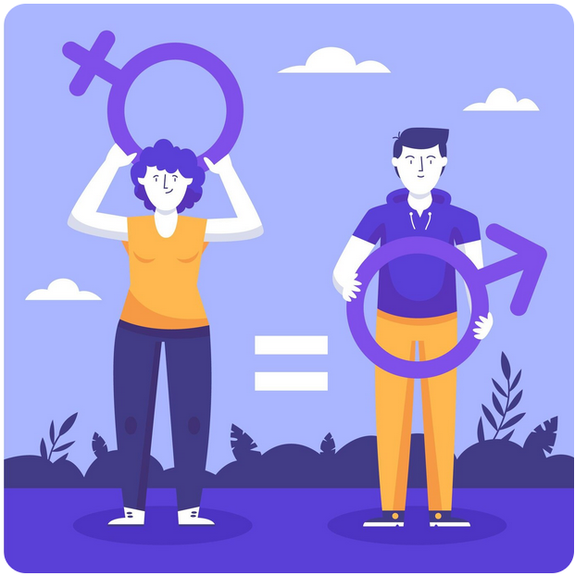
Why implementing gender mainstreaming in organizations
Gender mainstreaming = a strategy towards achieving gender equality.
Integrate a gender perspective into the planning, designing, implementing, monitoring, and evaluating of policies, projects, products, and/or services.
Analyze the current state of affairs to pinpoint inequalities and creating meant to address those imbalances
Notes:
Gender mainstreaming = a strategy towards achieving gender equality.
It entails integrating a gender perspective into the planning, designing, implementing, monitoring, and evaluating of policies, projects, products, and/or services.
It entails analyzing the current state of affairs to pinpoint inequalities and creating meant to address those imbalances and reverse the processes that created them.
It requires a contextual analysis of the needs, interests, roles and experiences of women and men, as well as the integration of specific actions to address any gender-based inequalities that may have emerged from this analysis.
We have seen before what integrating a gender perspective into the policies of a company can do, and we can highlight some indisputable and measurable advantages again:
Corporate attractiveness
Performance
Well-being at work
Enhancing Competitiveness

Slide 20
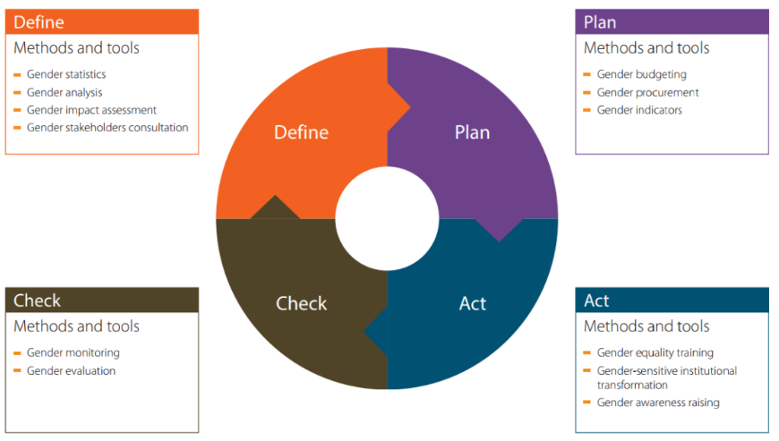
Why implementing gender mainstreaming in organizations
Integrating the gender perspective in a policy = equality between women and men should be taken into consideration in all decisions, in each phase of the policy-making process, by all the actors involved.
The policy process is understood as a multi-stage cycle, including defining, planning, implementing and checking (monitoring and evaluating).

Slide 21
Why implementing gender mainstreaming in organizations
Our Penelope project provides you with tools to help you make this happen :
the Penelope GENDER EQUALITY TRAINING HANDBOOK (good practices, interviews and tools related to gender mainstreaming)
a Video Toolkit (practical tools and insights to promote gender equality in the workplace).
the Virtual Learning Environment : a training designed specifically for SMEs. For example : how to conduct a gender audit, how to develop a gender equality strategy, a gender inclusive budget, a gender equality monitoring plan, how to integrate the gender perspective in the talent recruitment and in the overall work environment.
Notes:
Our Penelope Project offers you the following tools you can use for developing a gender equality strategy and integrating the gender perspective in your activities:
the Penelope GENDER EQUALITY TRAINING HANDBOOK - SUPPORTING EUROPEAN CLUSTERS TOWARDS GENDER MAINSTREAMING, with good practices, interviews and tools related to gender mainstreaming
a Video Toolkit designed to equip organizations with practical tools and insights to promote gender equality in the workplace.
the Virtual Learning Environment, where you will find a training designed specifically for SMEs, in order to help them build a gender-inclusive company culture and to develop internal strategies to solve potential gender inequities in the workplace, contributing to the basis of broad-based, long-term, and substantial reforms within European SMEs landscape, where you can learn, amongst other things, how to conduct a gender audit, how to develop a gender equality strategy, a gender inclusive budget, a gender equality monitoring plan, how to integrate the gender perspective in the talent recruitment and in the overall work environment.

Slide 22
2. SMEs TRAINING PLATFORM DISCOVERY

Slide 23
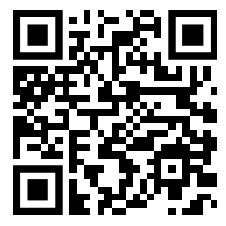
CONNECT TO OUR SME TRAINING PLATFORM!
https://penelope.learning-platform.eu/en
QR CODE

Slide 24
PLATFORM PRESENTATION
Connexion
Home page
COST ANALYSIS
Notes:
The Virtual Learning Environment comes with a USER GUIDE that will provide any information necessary for navigating and using the platform.
The first step will be, of course, creating an account and registering on the platform.
Use your entire name and surname and do it correctly, because they will appear on the certificate that you will obtain in case you take all the training courses and activities.
After logging in, you will access the “Home” screen, where these PENELOPE virtual learning environment guidelines are available for download on the left of the page. In addition, there is a short introduction to the course, with a video that explains the whole PENELOPE training course

Slide 25
PLATFORM PRESENTATION
Training for Cluster or SMEs
Navigate in the training page
COST ANALYSIS
Notes:
In order to access the different training paths, you need to click on the “Training” icon in the top menu.
You will see the two training paths, one for clusters and one for SMEs.
The next steps will be to choose one, enroll and join the training!
The learning path consists of PDF presentations, videos, and practical exercises. To progress through the training content, simply click the "Next" button. This will take you to the next activity, and the platform will automatically register your completion of the current activity.

Slide 26
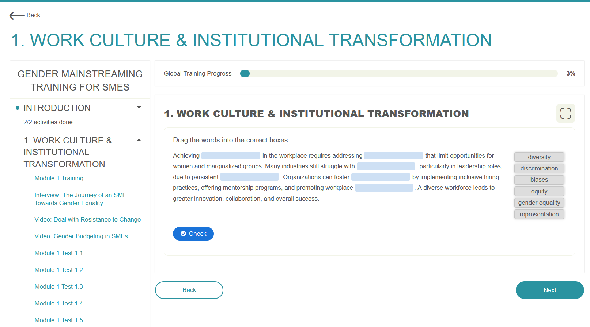
PLATFORM PRESENTATION
Videos
Activities
COST ANALYSIS
Notes:
You can watch videos directly in the VLE, without necessity to go to YouTube. Once finalized, you need to follow the same step as previously, clicking in the “Next” button to access to the next video or activity.
Important: If you don’t click the "Next" button in each activity, it will remain marked as "Pending" in the progress status. Make sure to go through all activities and learning materials by clicking "Next" to ensure they are completed.
Each training module contains different type of activities:
✓ Multiple choice test.
✓ True or false test.
✓ Drag the word.
✓ Find the word
You can access any of the training modules included in the learning path, but you will only obtain the certificate for your chosen learning path if you pass all the gamification activities in
each course. You need at least 60% correct answers to pass each activity and you have up to four tries per activity, but you can "Redo" the training activities until you earn the PENELOPE course certificate.
You can keep track of your progress on the home page in the "Latest Activity" section, where the global progress percentage is displayed. Clicking on it will take you directly to the training module section.

Slide 27
PLATFORM PRESENTATION
Training progress
COST ANALYSIS
Notes:
You can check the global training progress of a specific module in the “Training” and “See Progress” sections
The VLE is very intuitive and user friendly and the used guide answers all the possible questions you may have

Slide 28
E-learning training for SMEs
Introduction | Introduction to basic gender mainstreaming in SMEs.
1. Workplace Culture & Institutional Transformation | Tool #1 - Perform a gender audit of the status quo in your organization Tool #2 - Establish a gender equality strategy to foster institutional transformation Tool #3 - Deal with resistance to change and opposition to gender equality Tool #4 - Set goals to improve the level of gender inclusion of your workforce
2. Talent Recruitment | Tool 5: Building an inclusive talent brand. Tool 6: Improve recruiting procedures and eliminate potential bias
3. Career Progression & Access to Training | Tool 7: Bridge the gender promotion gap Tool 8: Invest in skills and training through a gender lens
4. Equal Pay | Tool 9: Conduct an equal pay audit and analyze potential gender pay gaps Tool 10: Promote and ensure equal remuneration
5. Working Conditions, Health, and Occupational Safety | Tool 11: Integrate the gender perspective in the prevention of occupational risk Tool 12: Support your employees during menstruation and menopause
6. Maternity, Work-Life Balance & Flexible Working Arrangements | Tool 13: Protect maternity and support expecting and new mothers in the workplace Tool 14: Build a flexibility strategy for a hybrid and high-performing workplace
7. Sexism and Harassment in the Workplace | Tool 15: Understand sexism to prevent gender-based harassment in the workplace Tool 16: Set in place a sexual harassment policy in your organization
8. Gender Monitoring, Performance & Reporting | Tool 17: Create a monitoring and evaluation strategy Tool 18: Draft an evaluation report.
Notes:
Now let’s go a bit into details about the training path for SMEs!
This training program is designed to help SMEs foster a more inclusive and equitable workplace by integrating gender equality strategies into their operations. By addressing key areas such as recruitment, career progression, and workplace culture, SMEs can not only meet legal and ethical obligations, but also enhance innovation, employee satisfaction, and overall business performance.
A diverse and inclusive workforce leads to improved decision-making, increased creativity, and a stronger reputation in the market. This training equips SMEs with practical tools and actionable strategies to implement gender-inclusive policies, ensuring long-term sustainability and growth in a competitive business environment.
The training course for SMEs contains the following modules:

Slide 29
3. PRACTICAL PART

Slide 30
Workplace Culture & Institutional Transformation
These Tools for Gender Mainstreaming are designed to support gender equality strategy implementation, evaluation, and transformation and you can find further details in Module 1: Workplace Culture & Institutional Transformation
Importance of a Gender Equality Strategy
Serves as the foundation for gender diversity initiatives and progress tracking.
Establishes a framework for commitments and actions towards gender equality.
Key Elements of the Strategy
Defines goals, activities, responsibilities, and timelines.
Uses gender audit results to create a targeted action plan addressing identified gaps.
Comprehensive Approach for Success
Moves beyond isolated, ineffective gender equality measures.
Ensures proper allocation of funds and resources for gender initiatives.
Encourages organization-wide collaboration and commitment to shared goals.
Why a Strategy Matters
Provides clarity in daily decisions to align with long-term gender equality objectives.
Without it, assessing progress and impact becomes difficult

Slide 31
Workplace Culture & Institutional Transformation
As explained by the Australian Government’s Workplace Gender Equality Agency13, a gender equality strategy:
Outlines a gender equality vision for an organization
Connects to the business or organizational strategy.
Identifies practical goals.
Includes measurable objectives linked to goals.
Encourages active and inclusive leadership.
Is simple to communicate.
Holds an organization accountable for its progress on equality between men and women.
Follows a transparent governance process.
Goes beyond equality between men and women to consider other elements of inclusion.
Is integrated with all divisions and organizational levels.
In the Module 1 you will learn how to Perform a gender audit of the status quo in your organization, how to establish a gender equality strategy to foster institutional transformation and how to set goals to improve the level of gender inclusion of your workforce, all with clear explanations and step-by-step instructions. Even more, you will also learn how to deal with resistance to change and opposition to gender equality.

Slide 32
ACTIVITY IN PAIRS
Step 1
Step 2
Step 3
List of questions:
1.
2.
3.
4.
5.
Form pairs and each pair chooses a question and thinks about the answers
Present the correct answer to each question

Slide 33
QUESTIONS AND ANSWERS
Step 1
List of questions:
1. During the recruitment process, what can be done to prevent discrimination between men and women?
2. What does workplace gender equality truly mean in practice?
3. How to ensure women have equally access to trainings and thus to upskilling and carreer progression?
4. How can gender biases be recognized and what can be done to address them?
5. XXX

Slide 34
QUESTIONS AND ANSWERS
QUESTION 1: During the recruitment process, what can be done to prevent discrimination between men and women?
ANSWER
Write a gender-neutral job description (don't gender job names, avoid expressions considered too feminine or masculine in rather masculine jobs, don't indicate too many requirements so as not to discourage potential candidates).
Clearly show that the company is active in favor of equality between men and women
Vary distribution channels and favor open procedures.and try the introduction of blind CVs
Ensure that selection panels include an equal number of men and women
Train those responsible for recruitment in gender equality issues
Do not devalue career breaks or non-traditional career choices
Use objective assessment methods based on candidates' skills during selection and interviews

Slide 35
QUESTIONS AND ANSWERS
QUESTION 2: What does workplace gender equality truly mean in practice?
ANSWER
Workplace gender equality in practice means that people of all genders have equal rights, responsibilities, and opportunities at every level of the organization.
This includes equal pay for equal work, fair access to hiring and promotions, balanced representation in leadership, and the elimination of discrimination, harassment, and gender bias in policies, company culture, and daily interactions.
It also means recognizing and addressing the different challenges and barriers faced by women through supportive policies like flexible work or parental leave.

Slide 36
QUESTIONS AND ANSWERS
QUESTION 3: How to ensure women have equally access to trainings and thus to upskilling and carreer progression?
ANSWER
It is recommended to avoid hosting training sessions or team-building exercises after work hours oron the weekends or far away from the company as these may be challenging for staff members who have caringobligations to attend (family and household responsabilities are still often the primary responsibility of women).
To be completed

Slide 37
QUESTIONS AND ANSWERS
QUESTION 4: How can gender biases be recognized and what can be done to address them?
ANSWER
Unconscious bias refers to the automatic judgments and stereotypes we hold about others without even realizing it. In the workplace, this can show up in subtle ways—like who gets interrupted in meetings, whose ideas are taken seriously or who’s assigned leadership roles; for example:
Women are more often expected to take on organizational or caregiving roles (note-taking, planning events, manage team morale).
Men may be more likely to be assigned leadership or technical tasks, even without explicit policies.
These patterns aren’t always intentional and often reflect traditional stereotypes rather than actual skills or interests. Recognizing these biases is the first step toward creating more balanced, merit-based practices and you can address it by
Offering training that raises awareness and provides practical tools for inclusive behavior.
Setting clear diversity and inclusion goals, and monitor progress regularly.- Creating a culture where everyone feels safe to speak up when they notice bias.

Slide 38
QUESTIONS AND ANSWERS
QUESTION 5: To be completed
ANSWER
To be completed

Slide 39
4. CONCLUSIONS AND EVALUATION

Slide 40

Gender equality awareness raising workshop for SMEs
Objectives of this workshop :
show you the most important aspects of the gender problematic and the need to implement specific company strategies.
present to you the PENELOPE training platform
Notes:
The first goal of this workshop was to show you some of the most important aspects of the gender problematic and the need to implement specific company strategies. This way, you will be able to understand the benefits of taking an interest in this subject, and get inspired to learn more and take appropriate and effective measures.
The second was to present to you the PENELOPE training platform, where you will find a wealth of training content and a variety of activities to help you understand in greater detail and implement actions tailored to the way your company operates.
Hopefully you will be motivated to take action and to go on our platform to get the help you need!

Slide 41
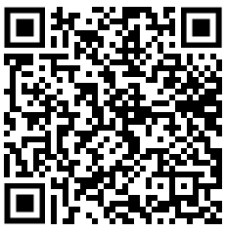
Please fill in the satisfaction questionnaire
Option 1
Option 2
You can fill in the questionnaire in the printed form
You can find the questionnaire on-line with this QR Code :

Slide 42




CONTACT US
penelope@oxalis-scop.org https://penelope-project.org/

Slide 43





PENELOPE has been funded by the European Union.
(2022-1-FR01-KA220-VET-000088824).
Views and opinions expressed are however those of the author(s) only and do not necessarily reflect those of the European Union or the European Education and Culture Executive Agency (EACEA). Neither the European Union nor EACEA can be held responsible for them.

